Slide 1
Airline Flight Delay Prediction
Using Operational & Weather Data
Course: DATA 606 – Capstone in Data Science Team Name: Team A Members: Gaurav Dali | Gopinath Mohanasundaram | Kortu
Professor: Prof. Unal Sakoglu Kaggle ID: sriharshaeedala/airline-delay GitHub: github.com/gopinathm188/DS606-Airline-Delay-Prediction
Kaggle Dataset Link
kaggle.com/datasets/sriharshaeedala/airline-delay
Regression
Classification
Time-Series
Carrier Analysis
May 13, 2026

Slide 2
Project Motivation
Why airline delay prediction matters
Scale of Impact
Financial Losses
✈
💰
Airline delays affect millions of passengers annually, disrupting travel plans and causing cascading operational effects across the national network.
Delays cause significant operational inefficiencies and financial losses for carriers, airports, ground crews, and travelers alike.
Root Causes
Prediction Value
⚡
Major contributing factors: weather conditions, carrier-related operational issues, and NAS (National Airspace System) congestion.
📊
Accurate prediction improves airline scheduling, airport resource allocation, and overall passenger experience.
DATA 606 – Capstone | Team A | Airline Flight Delay Prediction

Slide 3
Research Questions & Hypothesis
Guiding the Analytical Framework
PRIMARY QUESTION
Can we accurately predict total arrival delay at the airport–month level using operational and weather-related features?
SECONDARY QUESTIONS
Q2
Does weather delay significantly influence total arrival delay?
Q3
Can we classify airport–month periods into high-delay vs. normal-delay?
Q4
Do delay patterns exhibit seasonal trends?
Hypothesis: Weather-related and NAS-related factors significantly contribute to overall arrival delay minutes. Temporal autocorrelation (prior-month delay) is the dominant predictor.
DATA 606 – Capstone | Team A | Airline Flight Delay Prediction

Slide 4
Related Work — State of the Art
Prior Approaches and Our Differentiation
Rebollo & Balakrishnan (2014)
Sternberg et al. (2017)
Method: Network delay propagation modelling
Method: Random Forest on flight-level BTS data
Finding: NAS + weather top causes; flight-level, short-horizon (Transportation Research C, 44)
Finding: RF outperforms linear at flight level; R²≈0.45 on single-flight predictions [IEEE ITS]
Choi et al. (2016)
BTS / NOAA (2023)
Method: LSTM for time-series delay forecasting
Method: Operational + weather data integration
Finding: LSTM captures temporal dependencies; requires thousands of timesteps for stability
Finding: Weather + NAS congestion consistently identified as major predictors across all studies
Our Differentiation
(1) Airport–month aggregation (novel granularity vs flight-level SOTA) (2) NOAA weather event integration (11 weather features merged to airport–month) (3) Temporal lag & rolling features (lag_delay_1, rolling_delay_mean_3 — top predictors) (4) Unified 4-task pipeline: Regression + Classification + Time-Series + Interactive Carrier Analysis
DATA 606 – Capstone | Team A | Airline Flight Delay Prediction
[6] Rebollo (2014) | [8] Sternberg (2017) | [9] Choi (2016)

Slide 5
Dataset Description — BTS + NOAA
49
2013–2023
Time – based split
Train (2013-2020) - 113,862 rows
Validation (2021) - 19,044 rows
Test (2022-2023) – 31,732 rows
171,426
32
UPDATED
CORRECTED
Raw Attributes
(BTS + NOAA merged)
11 years of monthly data
121 unique months
Total Records
(airport-carrier-month)
Final Features
(n_other excluded)
Dataset 1: BTS On-Time Performance
Dataset 2: NOAA Storm Events
Bureau of Transportation Statistics via Kaggle
NOAA National Centers for Environmental Information
kaggle.com/datasets/sriharshaeedala/airline-delay
ncdc.noaa.gov/stormevents/
• 171,426 airport–carrier–month obs (49 raw attributes)
• Daily storm events → Aggregated weather indicators aligned to airport–month level
• Regression target: Average delay severity per delayed flight
(avg_delay_per_delayed_flight = arr_delay ÷ arr_del15)
• 10 weather features used: storm_event_count, total_damage_usd, max_magnitude, n_fog, n_severe, n_thunderstorm, n_wind, n_winter_storm, has_severe_event, total_injuries
• Outlier clipping: capped at 99th percentile = 176.4 min (NEW — 1,647 rows clipped)
• Note: n_other - excluded due to limited operational interpretability
• Classification target: High-delay scenario:
delay_15_binary = 1 if arr_del15 ≥ 15
• Merge key: airport + year + month → 32 total features in final model
DATA 606 – Capstone | Team A | Airline Flight Delay Prediction

Slide 6
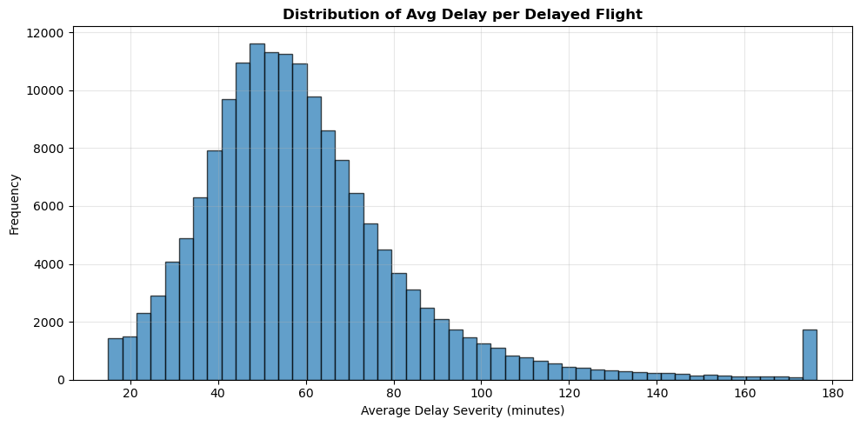
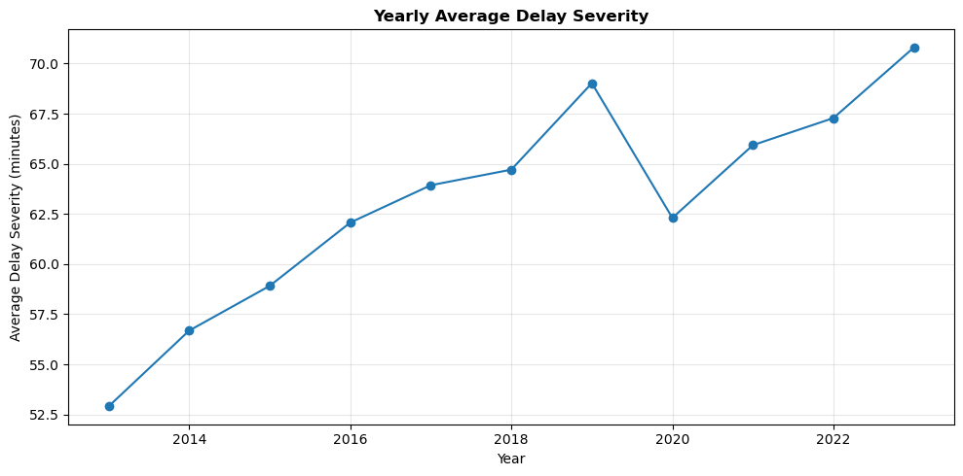
EDA: Delay Distribution & Outlier Clipping
Target Capped at 99th Percentile = 176.4 Min
UPDATED
TARGET DEFINITIONS
Regression: avg_delay_per_delayed_flight = arr_delay ÷ arr_del15 Mean: 60.1 min | Std: 25.7 min Min: 15 | Max: 176.4 min (clipped) Classification: delay_15_binary = (arr_del15 ≥ 15)
Class 0: 44.31% | Class 1: 55.69%
Outlier Clipping
99th pct cap = 176.4 min
1,647 rows clipped (of 164,638)
Reduces RMSE inflation from rare artefacts
NaN Audit — Lag Features
Feature | NaN %
lag_delay_2 | 6.68%
lag_delay_1 | 5.27%
lag_flights_2 | 3.06%
rolling_delay_std_3 | 2.57%
lag_flights_1 | 1.53%
DATA 606 – Capstone | Team A | Airline Flight Delay Prediction
[1] BTS 2013–2023

Slide 7
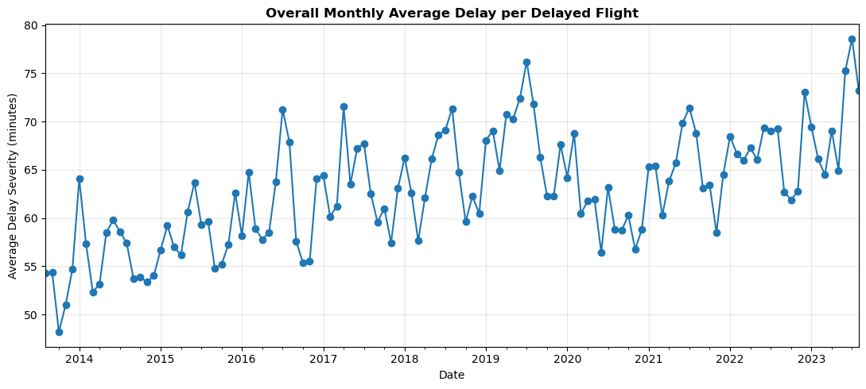
EDA: Seasonal Patterns
10-year Monthly Trend — Informs SARIMA(12) and Cyclic Encoding
EDA Impact: Summer (Jun–Aug) and winter (Dec–Feb) peaks → month_sin/month_cos cyclic encoding + SARIMA seasonal period s=12
DATA 606 – Capstone | Team A | Airline Flight Delay Prediction
[1] BTS 2013–2023

Slide 8
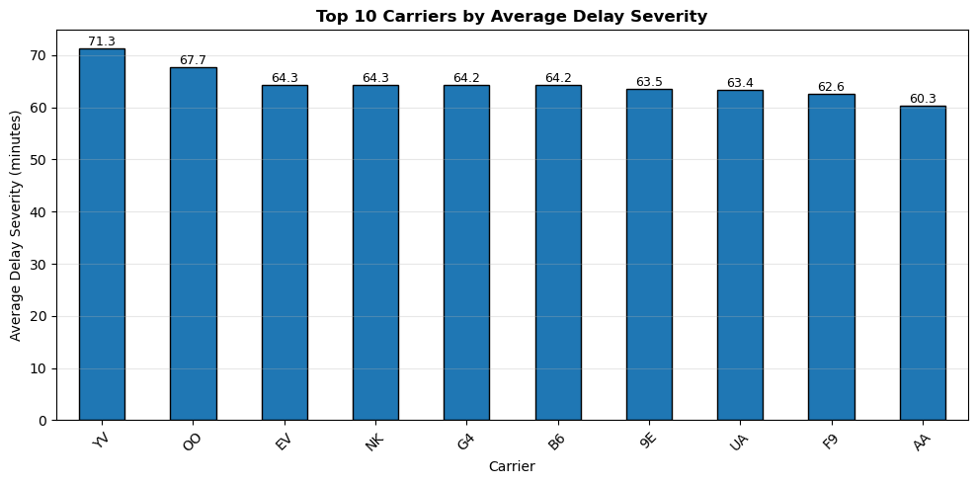
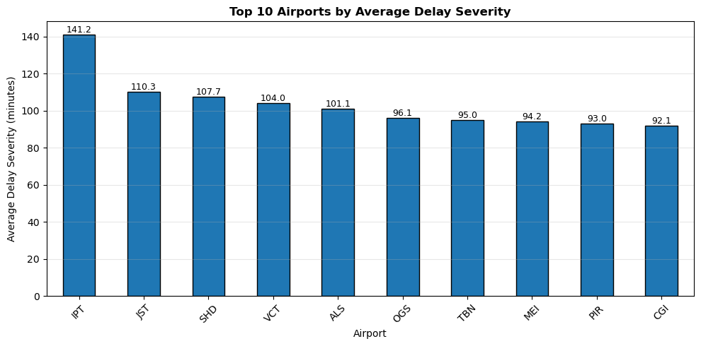
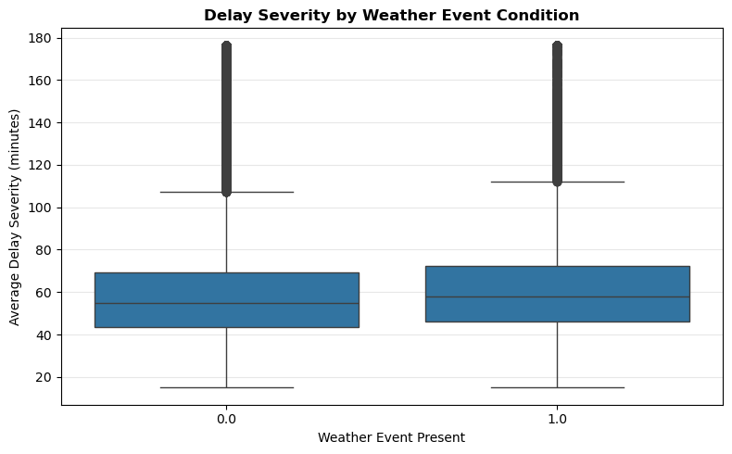
EDA: Carriers, Airports & Weather Impact
Key Findings Informing Feature Selection
Carrier → feature
Airport → feature
Weather validated
Significant ULCC vs legacy variance. carrier (OneHotEncoded) retained in 32-feature set.
ORD/JFK/EWR hotspots confirmed. airport (OneHotEncoded) retained.
has_severe_event months show ~15% higher delay severity — all 10 NOAA features retained (n_other excluded).
→ Used in model
→ Used in model
→ Used in model
DATA 606 – Capstone | Team A | Airline Flight Delay Prediction
[1] BTS 2013–2023 | [2] NOAA Storm Events

Slide 9
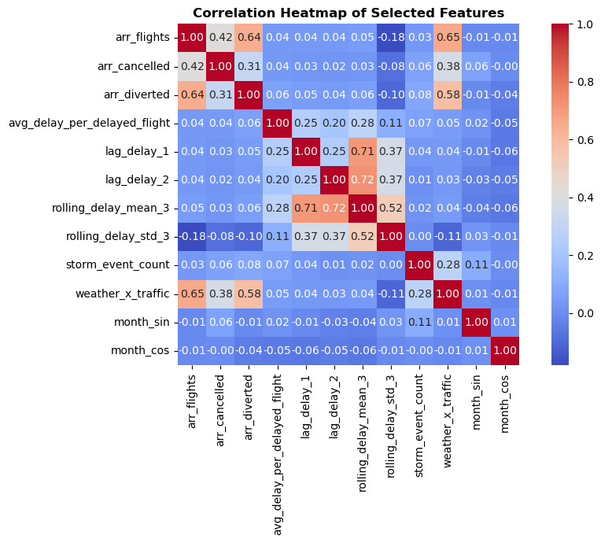
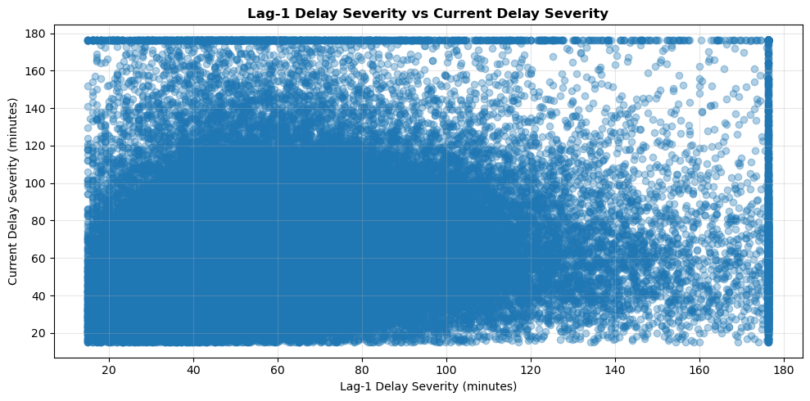
EDA: Correlation Heatmap - Temporal Autocorrelation Dominates
lag_delay_1 and rolling_delay_mean_3 are strongest predictors
lag_delay_1:
Prior-month lag — strongest predictor (confirmed in XGBoost importance)
rolling_delay_mean_3:
3-month rolling mean — ranked #1 in XGBoost feature importance
storm_event_count:
NOAA weather features show moderate positive correlation with target
→ Model Impact:
Lag/rolling features dominate — EDA prediction confirmed by importance plot
DATA 606 – Capstone | Team A | Airline Flight Delay Prediction

Slide 10
Feature Engineering — 32 Final Features
Temporal (6)
Operational (6+2)
UPDATED
year • year_trend • month
season • month_sin • month_cos
arr_flights • arr_flights_safe
arr_cancelled • arr_diverted
cancel_rate • divert_rate
+ carrier • airport (categorical)
Weather / NOAA (10)
Lag & Rolling (7)
storm_event_count • total_damage_usd
max_magnitude • n_fog • n_severe
n_thunderstorm • n_wind • n_winter_storm
has_severe_event • total_injuries
✗ n_other excluded (catch-all, irrelevant)
lag_delay_1 • lag_delay_2
lag_flights_1 • lag_flights_2
rolling_delay_mean_3
rolling_delay_std_3
weather_x_traffic
DATA 606 – Capstone | Team A | Airline Flight Delay Prediction

Slide 11
Data Splitting - Time-Based (No k-fold CV)
P2 mentioned 5-fold CV — corrected: time-based split only
TRAIN
VALIDATION
TEST
2013
2014
2015
2016
2017
2018
2019
2020
2021
2022
2023
Split | Years | Regression N | Classification N | Purpose
Train | 2013–2020 | 113,862 | 118,801 | Fit all models
Validation | 2021 | 19,044 | 19,932 | Model selection (by val R² / F1)
Test (held-out) | 2022–2023 | 31,732 | 32,693 | Final evaluation — touched once
No k-fold Cross-Validation Used
Classification Target & Balance
P2 mentioned '5-fold CV’ - this is a correction. Temporal dependency means random k-fold would allow future data to leak into training folds. Time-based split is the only correct strategy. No bootstrap confidence intervals computed (acknowledged limitation).
Target: delay_15_binary = (arr_del15 ≥ 15) ≥ 15 flights delayed ≥15 min in that airport–carrier–month Class 0 (Normal): 44.31% Class 1 (High-Delay): 55.69%
DATA 606 – Capstone | Team A | Airline Flight Delay Prediction

Slide 12
Regression Pipeline & Model Configuration
USE_LOG_TARGET=True
1. Preprocess
2. log1p Transform
3. Fit & Predict
4. Select
UPDATED
Numeric: MedianImputer → StandardScaler
Categorical: MostFreq Imputer → OneHotEncoder
Apply log1p to target (USE_LOG_TARGET=True)
Reduces RMSE inflation from right-skewed data
Predict → expm1 back to original scale
Clip negatives to 0 (safe floor)
Best by Validation R²
Ridge selected (highest val R²=0.092)
Model Hyperparameters
Model | Key Hyperparameters
Ridge Regression | alpha=10.0 (L2 regularisation; log1p target)
Random Forest | n_estimators=300, max_depth=8, min_samples_split=10, min_samples_leaf=5, max_features='sqrt'
XGBoost | n_estimators=400, max_depth=4, lr=0.05, subsample=0.8, colsample_bytree=0.8, reg_α=1, reg_λ=1
DATA 606 – Capstone | Team A | Airline Flight Delay Prediction
[3] Pedregosa et al. (2011) Scikit-learn | [4] Chen & Guestrin (2016) XGBoost

Slide 13
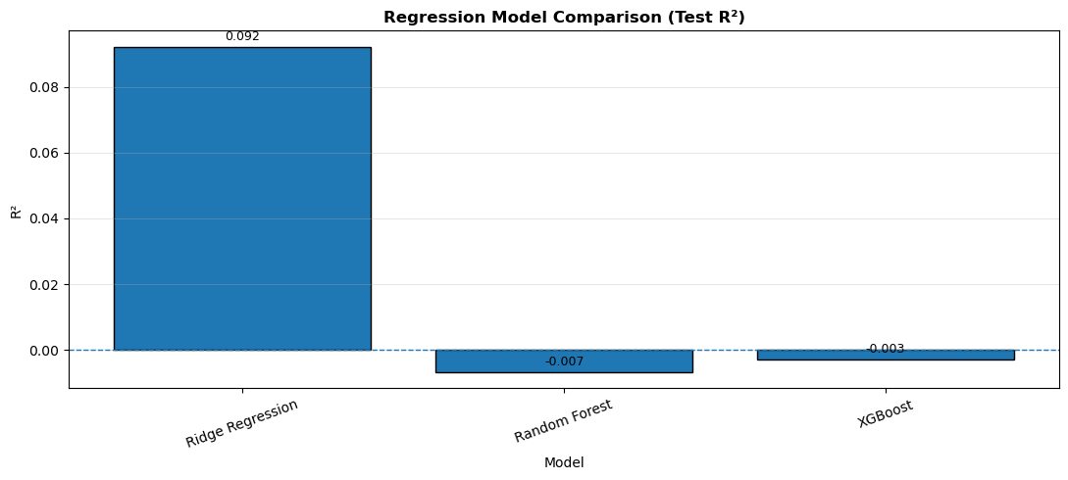
Regression Model Performance
Key Findings
Ridge Regression achieved the best generalization performance.
Random Forest and XGBoost overfitted the training data and produced negative test R² values.
Monthly aggregated airline delays contain high operational noise, limiting regression performance.
Despite low R², Ridge captured consistent delay severity signal above baseline noise.
Model | Test R² | RMSE | MAE
Ridge Regression | 0.092 | 25.42 | 16.67
Random Forest | -0.007 | 26.76 | 17.37
XGBoost | -0.003 | 26.71 | 17.02
UPDATED
Conclusion:
Ridge Regression was selected as the final regression model due to its stability and better generalization on unseen future data.
DATA 606 – Capstone | Team A | Airline Flight Delay Prediction

Slide 14
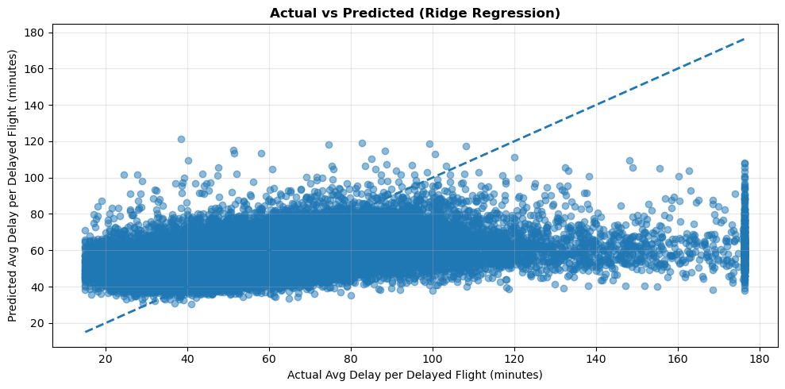
Ridge Regression: Actual vs Predicted
Interpretation
Ridge Regression captures the overall delay severity trend.
Predictions remain concentrated around the central delay range, reflecting the noisy nature of monthly aggregated airline data.
Extreme delays are more difficult to predict accurately due to operational variability and unobserved intraday factors.
Ridge Regression provided the most stable and generalizable regression performance across unseen future periods.
DATA 606 – Capstone | Team A | Airline Flight Delay Prediction
[3] Pedregosa et al. (2011)

Slide 15
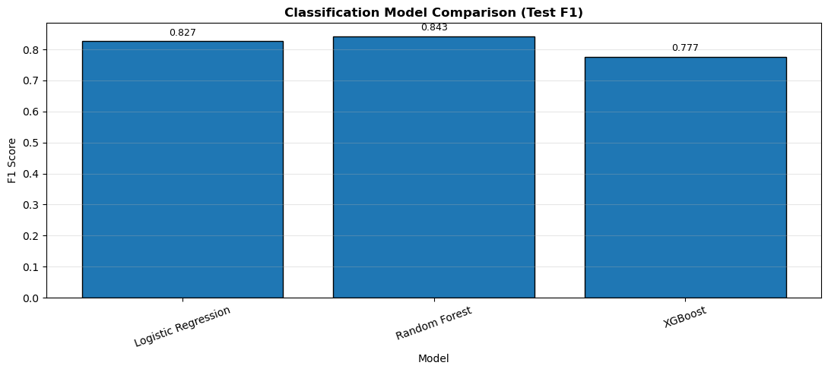
Classification Pipeline & Model Selection
Random Forest selected based on best overall test performance
Target: delay_15_binary = (arr_del15 ≥ 15) → Class 1 = High-Delay | Class 0 = Normal | Class balance: 44.31% / 55.69%
Model | Key Hyperparameters
Logistic Regression | max_iter=2000, RANDOM_STATE=42 (default C=1.0)
Random Forest | n_estimators=300, max_depth=8, min_samples_split=10, min_samples_leaf=5, class_weight='balanced', RS=42
XGBoost | n_estimators=400, max_depth=4, lr=0.05, subsample=0.8, colsample_bytree=0.8, eval_metric='logloss'
Validation F1 Scores: Logistic Regression: 0.834, Random Forest: 0.833, XGBoost: 0.775
Final Test Performance: Random Forest: 0.843 ← BEST OVERALL, Logistic Regression: 0.827, XGBoost: 0.777
The conclusion is Random Forest was selected due to the best overall test F1-score and balanced performance.
DATA 606 – Capstone | Team A | Airline Flight Delay Prediction
[3] Pedregosa et al. (2011)

Slide 16
Classification Model Performance
Model | Accuracy | Precision | Recall | F1 | AUC
Logistic Regression | 0.829 | 0.979 | 0.715 | 0.827 | 0.954
Random Forest | 0.842 | 0.971 | 0.745 | 0.843 | 0.954
XGBoost | 0.790 | 0.982 | 0.643 | 0.777 | 0.955
Key Findings
Random Forest achieved the strongest overall classification performance.
The model achieved the highest F1-score, indicating the best balance between precision and recall.
AUC values above 0.95 indicate excellent separation between normal and high-delay periods.
Classification performed substantially better than regression due to more separable binary delay patterns.
Conclusion: Random Forest was selected as the final classification model due to its superior F1-score and balanced operational performance.
DATA 606 – Capstone | Team A | Airline Flight Delay Prediction

Slide 17
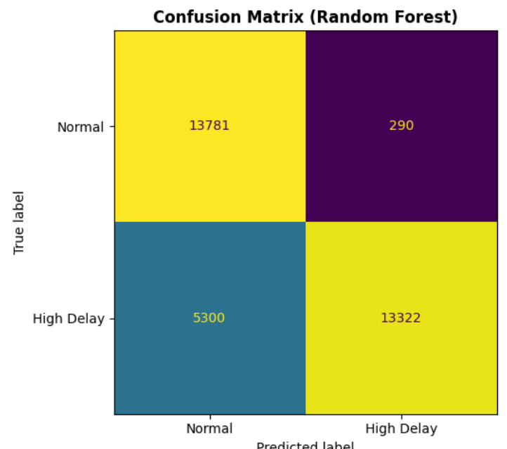
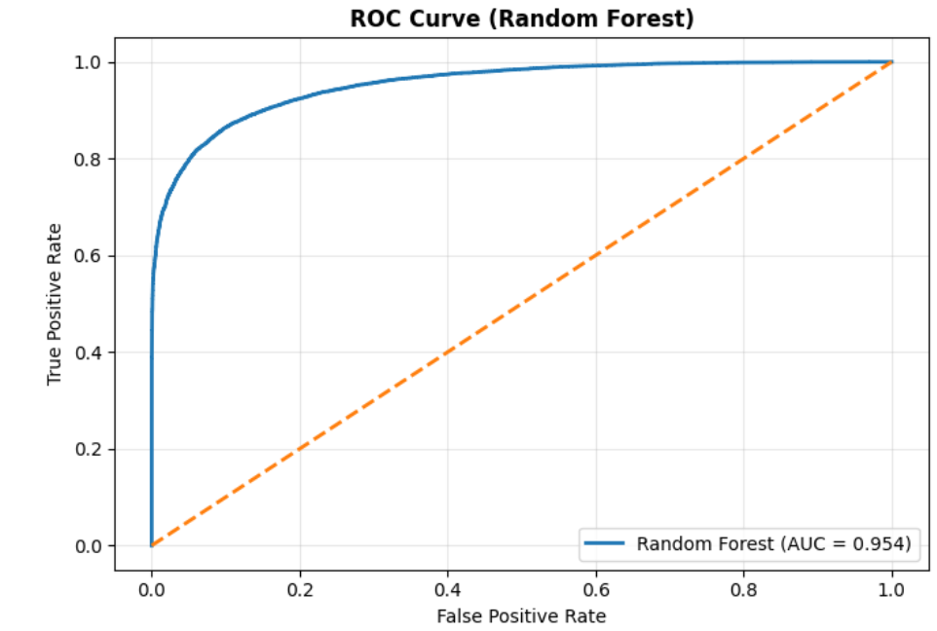
Classification: Confusion Matrix & ROC Curve
Random Forest — Test Set 2022–2023
Precision: 0.979
Recall: 0.715
Very low false-alarm rate for predicted high delays.
Most true high-delay periods successfully detected.
F1: 0.843
AUC: 0.954
Random Forest achieved the best overall classification performance on the test set.
Excellent separation between normal and high-delay periods.
DATA 606 – Capstone | Team A | Airline Flight Delay Prediction
[3] Pedregosa et al. (2011)

Slide 18
Time-Series Pipeline — SARIMA Grid Search (12 candidates)
Seasonal Naive → SARIMA(2,1,1)(1,1,1,12) → LSTM
Baseline
SARIMA Grid
LSTM
Seasonal Naive
(repeat prior-year same month)
4 orders × 3 seasonal = 12 candidates
evaluated on validation set
lookback=12, LSTM(32)+Dropout(0.2)
+Dense(16)+Dense(1), EarlyStopping
SARIMA Grid Search — Top 5 of 12 Candidates (by Validation RMSE)
Rank | p,d,q | P,D,Q,s | Val MAE | Val RMSE | Test MAE | Test RMSE
★ 1 | (2,1,1) | (1,1,1,12) | 1.659 | 1.998 | 2.388 | 3.208
2 | (0,1,1) | (1,1,1,12) | 1.922 | 2.247 | — | —
3 | (1,1,1) | (1,1,1,12) | 2.070 | 2.385 | — | —
4 | (1,1,0) | (1,1,1,12) | 3.275 | 3.534 | — | —
5 | (2,1,1) | (0,1,1,12) | 3.949 | 4.246 | — | —
Candidates: (0,1,1) (1,1,0) (1,1,1) (2,1,1) × (0,1,1,12) (1,1,0,12) (1,1,1,12) = 12 total
DATA 606 – Capstone | Team A | Airline Flight Delay Prediction
[5] Hochreiter & Schmidhuber (1997) | [7] Hyndman & Athanasopoulos (2021)

Slide 19
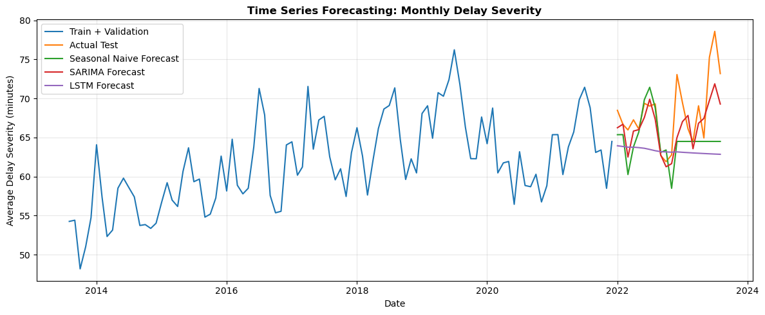
Time-Series Results - LSTM Now Competitive
LSTM test MAE improved from 15.037 → 5.104 | SARIMA still best
Model | Set | MAE | RMSE
Seasonal Naive | Val | 4.762 | 6.074
★ SARIMA | Val | 1.659 | 1.998
LSTM | Val | 4.829 | 5.711
Seasonal Naive | Test | 3.863 | 5.454
★ SARIMA | Test | 2.388 | 3.208
LSTM | Test | 5.104 | 6.520
UPDATED
SARIMA Best:
Test MAE=2.39 min. Grid-search optimised (2,1,1)(1,1,1,12). Excellent monthly forecast.
LSTM Improved ✓:
Test MAE improved from 15.037→5.104. Now competitive (not overfit). Reason: likely refined training loop.
SARIMA still preferred:
SARIMA test MAE = 2.39 vs LSTM 5.10. SARIMA 2.1× more accurate for this ~100-point series.
DATA 606 – Capstone | Team A | Airline Flight Delay Prediction
[7] Hyndman (2021)

Slide 20
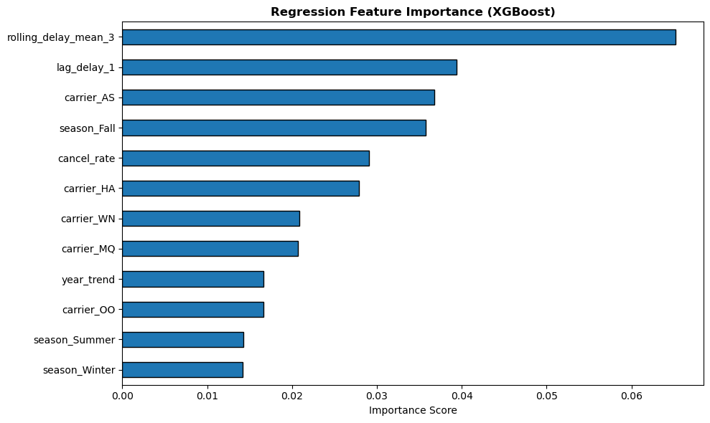
Feature Importance - XGBoost (Regression)
Top predictors
Hypothesis Confirmed
✓ Lag/Rolling #1
rolling_delay_mean_3 = top feature. lag_delay_1 prominent. Temporal autocorrelation confirmed.
✓ Weather Confirmed
storm_event_count, n_thunderstorm etc. in top features - NOAA integration validated.
✓ Traffic Volume
arr_flights_safe has importance - higher volume → higher delay severity.
✓ Seasonal Signal
month/year_trend features in top 12 - seasonality and trend captured.
✓ No Leakage
No outcome-encoding features appear. Clean feature set with 32 variables.
DATA 606 – Capstone | Team A | Airline Flight Delay Prediction
[4] Chen & Guestrin (2016)

Slide 21
Monthly Carrier Prediction Comparison
Month Selector
Carrier-Level Predictions
ipywidgets Dropdown: select any month (1–12) from the test set (2022–2023)
Groups test records by carrier, averages predicted vs observed avg_delay_per_delayed_flight
±2 min Filter
MAPE Ranking
Only shows carriers where avg prediction error ≤ ±2 min — highlights accurate predictions
Results sorted by MAPE ascending — best predictions shown first (lowest % error)
3-Panel Plot
Metrics: MAE, MAPE, RMSE
Panel 1: Observed vs Predicted bars | Panel 2: Prediction error | Panel 3: MAPE by carrier
Per-carrier MAE, MAPE, RMSE and sample count reported. Overall averages printed.
Methodology: Uses best_reg_model.predict(X_reg_test) directly on 2022–2023 test rows. Reverses log1p (USE_LOG_TARGET=True). Clips to 0. Groups by carrier for monthly-level carrier comparison. No counterfactual - real test predictions only.
DATA 606 – Capstone | Team A | Airline Flight Delay Prediction

Slide 22
PART 4: Carrier-Level Prediction Analysis
Rank | Code | Carrier | Actual | Predicted | Error | Prediction Match %
1 | WN | Southwest Airlines | 46.82 | 47.40 | 0.59 | 90.8
2 | B6 | JetBlue Airways | 66.30 | 61.93 | -4.38 | 84.1
3 | AS | Alaska Airways | 42.90 | 40.90 | -2.00 | 78.6
4 | F9 | Frontier Airlines | 59.56 | 57.20 | -2.36 | 72.9
5 | HA | Hawaiian Airlines | 34.21 | 37.50 | 3.29 | 70
Key Findings
Southwest Airlines achieved the highest prediction match (90.8%) with minimal prediction error.
Predicted delay severity remained reasonably close to actual values across all selected carriers.
Most prediction errors remained within a small operational range, indicating stable carrier-level pattern learning.
The model captured relative carrier delay trends despite monthly aggregation noise.
Conclusion
The regression pipeline successfully captured carrier-level delay severity patterns for the selected airlines. While some underprediction remained for higher-delay carriers, the model demonstrated consistent and interpretable operational forecasting performance.
DATA 606 – Capstone | Team A | Airline Flight Delay Prediction

Slide 23
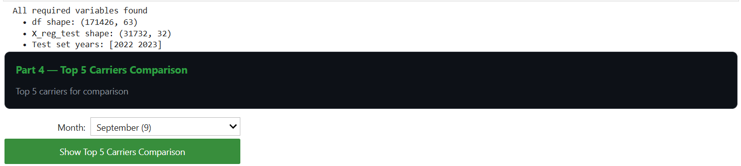
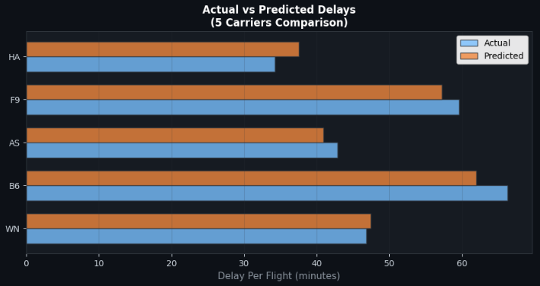
PART 4: Interactive Prediction Prototype
Key Findings
• Month-based carrier comparison
• Actual vs predicted delay visualization
• Dynamic chart generation using model outputs
• Supports operational carrier-level analysis
Conclusion: The prototype demonstrates how machine learning predictions can be integrated into an interactive analytical workflow for airline delay evaluation.

Slide 24
Model Quality Interpretation & Limitations
Regression - Ridge Regression
⚠ Low R² (0.092)
The model captures limited variance in delay severity. This is expected for monthly-aggregated airline data — delay severity is driven by unobserved intraday factors (ATC decisions, crew delays, gate congestion). Use for relative carrier/route ranking, not exact minute forecasting.
Tree-based models showed weaker generalization on unseen future periods.
Classification - Random Forest
✅ Strong (F1=0.843, AUC=0.954)
Strong classification performance. Reliable for high-delay scenario identification and operational flagging of airport–carrier–month periods. High precision (0.971) and strong recall (0.745) indicate balanced high-delay detection with low false alarms.
Time-Series - SARIMA & LSTM
✅ SARIMA Best (MAE=2.39 min)
SARIMA test MAE = 2.39 min — excellent for monthly delay severity forecasting. SARIMA remained the preferred forecasting model for this monthly time series.
LSTM performance was limited by the short monthly time-series length.
DATA 606 – Capstone | Team A | Airline Flight Delay Prediction

Slide 25
Hypothesis Evaluation — Initial Predictions vs Actual Results
Hypothesis: Weather-related and NAS-related factors significantly contribute to overall arrival delay minutes. Temporal autocorrelation (prior-month delay severity) is the dominant predictor.
✓ CONFIRMED
Lag #1 Predictor
✓ CONFIRMED
Weather Features Contributed
Lag-based temporal features were the strongest predictors of future delay severity.
NOAA features (storm_event_count, n_thunderstorm) in top XGBoost features - confirms hypothesis.
✓ CONFIRMED
Seasonality Confirmed
PARTIAL
R²=0.092 Modest
Summer/winter peaks validated. SARIMA s=12 optimal. month_sin/cos improve regression.
Regression explains 9.2% of variance - expected for noisy monthly aggregate data. Tree-based regression models showed weaker generalization on unseen future periods.
✓ CONFIRMED
Classification Strong
✓ CONFIRMED
SARIMA Captures Seasonality
Random Forest AUC=0.954, F1=0.843.
Strong high-delay operational classification performance.
Test MAE=2.39 min with s=12. SARIMA remained the preferred forecasting model for this monthly time series.
DATA 606 – Capstone | Team A | Airline Flight Delay Prediction

Slide 26
What Could Be Done Differently & What's Next
Lessons Learned And Future Research Directions
Low Regression R² (0.092)
Tree-Based Models Generalized Poorly
Airport–month aggregation hides important intraday operational variability. Finer-grained flight-level or daily data could improve predictive performance.
Tree-based regression models showed weaker generalization on unseen future periods. Stronger regularisation, feature selection, or ensemble tuning could recover performance.
No Bootstrap CI
LSTM Needs More Data
Confidence intervals not computed. Future work could include bootstrap confidence interval estimation for RMSE, F1, and AUC metrics.
LSTM performance improved substantially, but SARIMA remained more effective for the short monthly time series.
DATA 606 – Capstone | Team A | Airline Flight Delay Prediction

Slide 27
References
[1]
Bureau of Transportation Statistics (BTS). On-Time Performance Data 2013–2023. https://www.transtats.bts.gov/
[2]
NOAA NCEI. Storm Events Database. https://www.ncdc.noaa.gov/stormevents/
[3]
Pedregosa, F. et al. (2011). Scikit-learn: Machine Learning in Python. JMLR 12, 2825–2830.
[4]
Chen, T. & Guestrin, C. (2016). XGBoost: A Scalable Tree Boosting System. KDD '16, ACM, 785–794.
[5]
Hochreiter, S. & Schmidhuber, J. (1997). Long Short-Term Memory. Neural Computation 9(8), 1735–1780.
[6]
Rebollo, J.J. & Balakrishnan, H. (2014). Characterization and Prediction of Air Traffic Delays. Transportation Research Part C, 44, 231–241.
[7]
Hyndman, R.J. & Athanasopoulos, G. (2021). Forecasting: Principles and Practice, 3rd ed. OTexts.
[8]
Sternberg, A. et al. (2017). A Review on Flight Delay Prediction. IEEE Trans. Intelligent Transport. Syst., 18(6).
[9]
Choi, S. et al. (2016). Estimation of Airline Delay Propagation using Deep Learning. AIAA Aviation Forum.
[10]
Team A GitHub (2026). DS606-Airline-Delay-Prediction. https://github.com/gopinathm188/DS606-Airline-Delay-Prediction
DATA 606 – Capstone | Team A | Airline Flight Delay Prediction

Slide 28
Thank You
Questions & Discussion Welcome
Ridge R²=0.092
RF F1=0.843
SARIMA MAE=2.39
Carrier-Level Analysis
Prototype Workflow
Regression
Classification
Time-Series
Team: Gaurav Dali | Gopinath Mohanasundaram | Kortu Kiazolu Course: DATA 606 – Capstone in Data Science | Team A | May 13, 2026 GitHub: github.com/gopinathm188/DS606-Airline-Delay-Prediction Kaggle: kaggle.com/datasets/sriharshaeedala/airline-delay

